Slide 1
Title: BoxFit – Web Application Conceptual Design
Student Name: Fernando Silva
Matriculation Number: U14087143
Course: DLBCSPJWD01 – Project Java and Web Development
Submission Phase: Phase 2 – Development & Reflection
GitHub Link: https://github.com/FernandSilva/BoxClub.git
Filename: Silva_Fernando_U14087143 _PJWD _P2_S.pptx

Slide 2

Introducing BoxFit
BoxFit is a private, web-based social platform built for a dynamic boxing gym community in Hamburg.
Designed to connect gym members beyond training sessions, promoting motivation, accountability, and celebration of progress.
Members can post training updates, photos, videos, comment on others' posts, and follow each other.
Unlike public platforms, BoxFit offers a members-only, secure space to build an engaged and supportive gym community.

Slide 3

Target Users:
Audience & User Value
People of all ages looking to improve their fitness
Amateur and professional boxers
General fitness enthusiasts and gym-goers
Individuals starting their training journey or returning to fitness
Coaches, personal trainers, and group instructors
Anyone seeking a supportive, community-based training environment
User Benefits:
A motivating, interactive digital extension of the physical gym
Easy content sharing and peer recognition
Exclusive, private environment free from external distractions
Builds team spirit, consistency, and community support outside of training hours

Slide 4
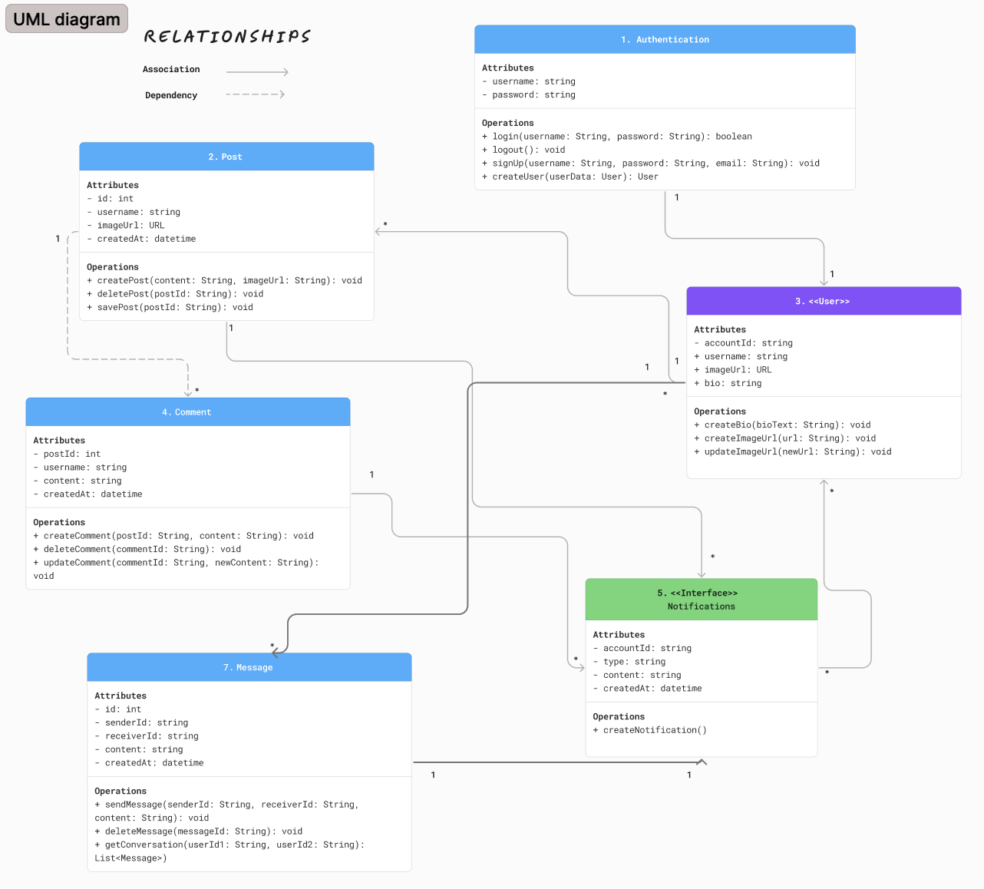
Technology Stack & System Design
Frontend:
ReactJS for the user interface.
React Query for state management.
Backend:
MongoDB handles authentication, database, and storage.
Infrastructure Flow:
React interacts directly with MongoDB backend.
Frontend logic is fully integrated with MongoDB backend.
Ensures responsive design and seamless user interactions

Slide 5

Key Components & Features
Authentication: Secure member login using Appwrite’s auth service.
Posts: Members can share text, media, and updates with the community.
Comments & Likes: Social interactions to foster engagement.
User Profiles: Display personal training progress and posts.
Notifications: Alert users to likes, comments, or new followers.
Messaging: Direct messaging between members to enhance interaction.
All features tightly integrated with MongoDB collections and React front-end components.

Slide 6
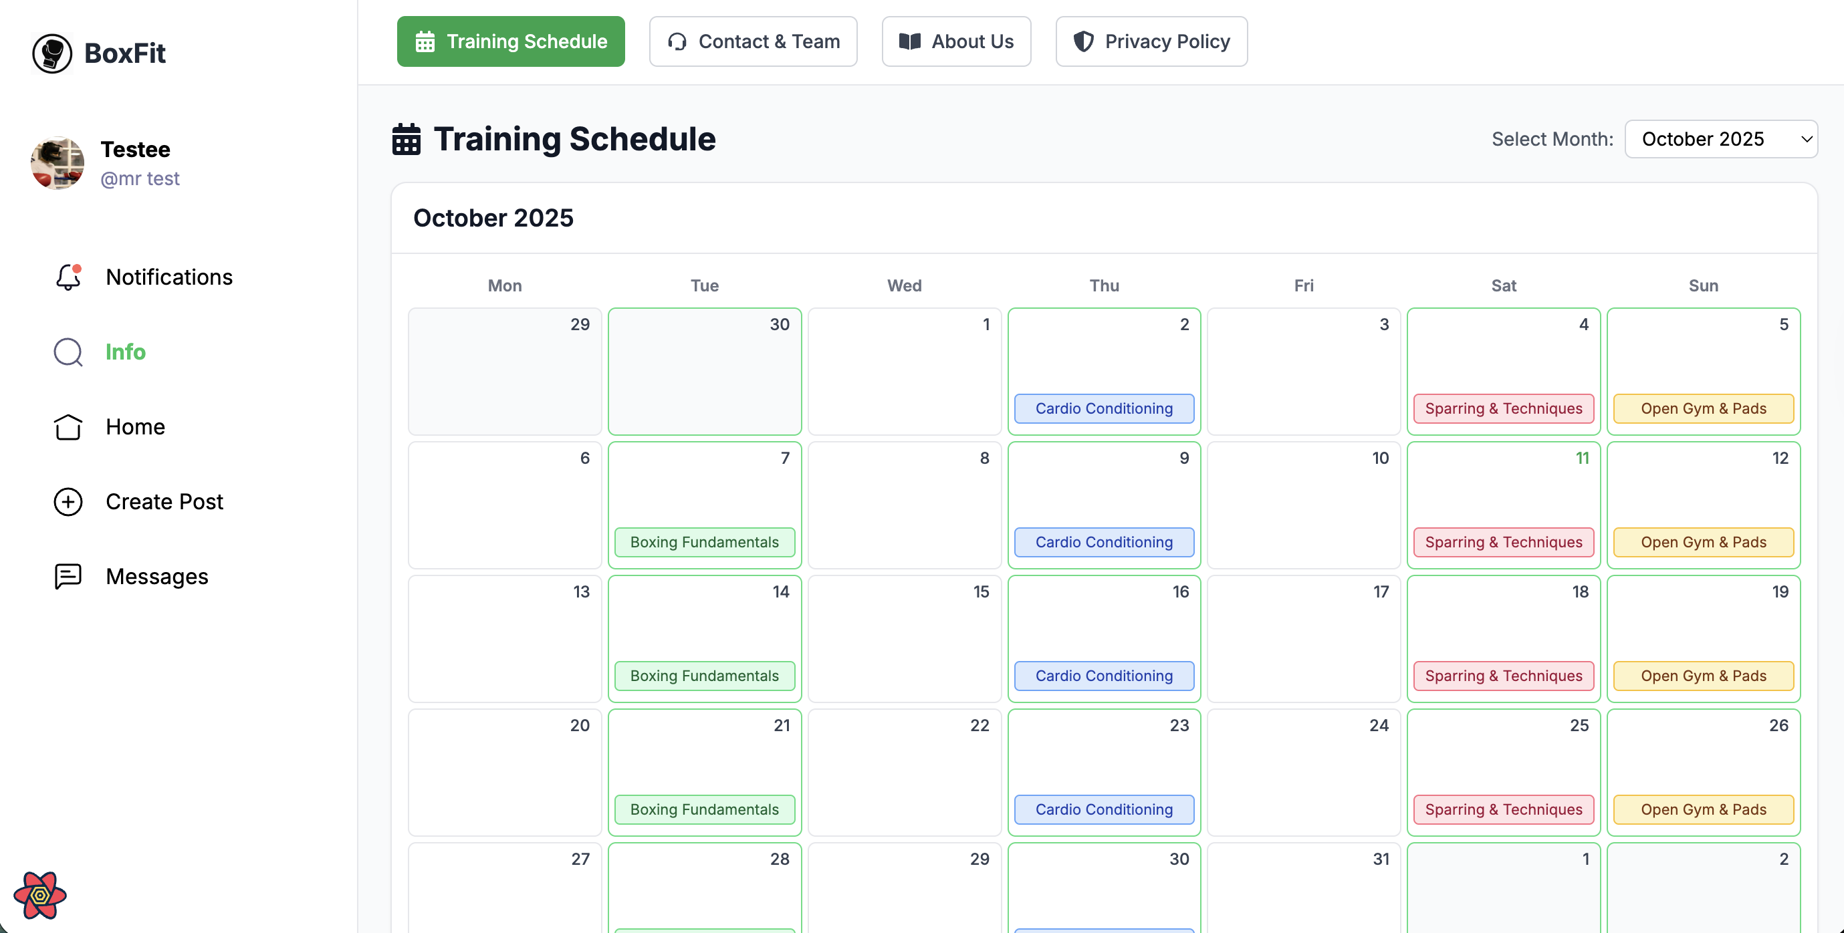
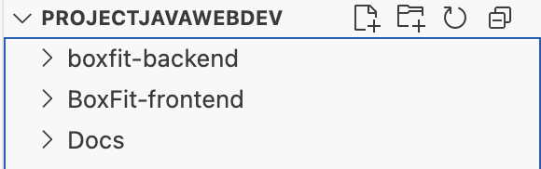
Development Overview
Phase 2 marks the full implementation of the BoxFit web application.
All planned features from Phase 1 have been realized, tested, and deployed in a local development environment.
The system integrates a React + TypeScript frontend with a MongoDB backend for secure data management.
The development focused on:
Authentication & User Profiles
Feed, Posts, Likes, Comments
Real-time Messaging and Notifications
Responsive Design and Accessibility
GitHub Repository:🔗 https://github.com/FernandSilva/BoxClub

Slide 7
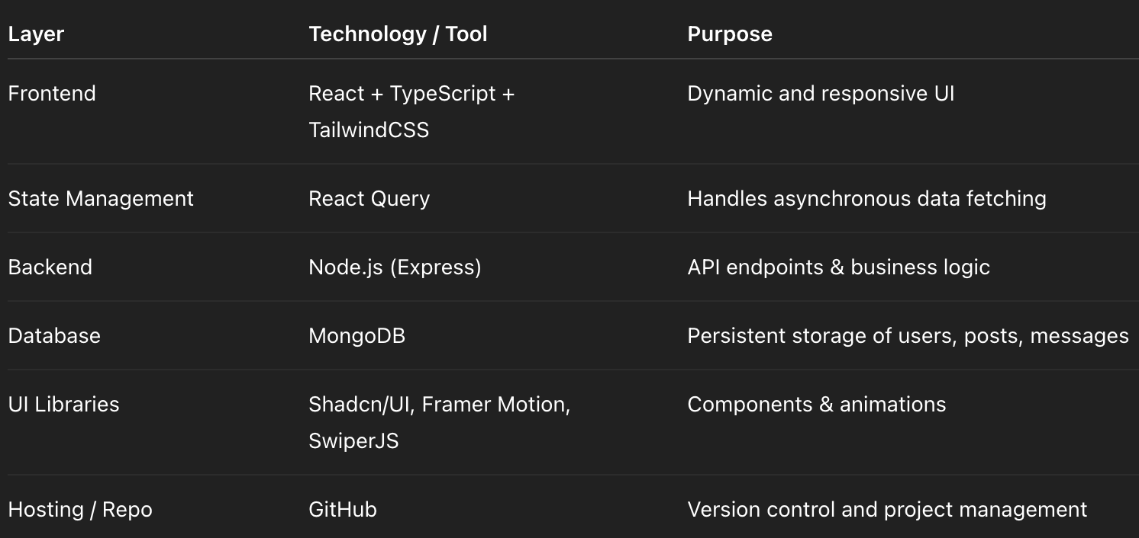
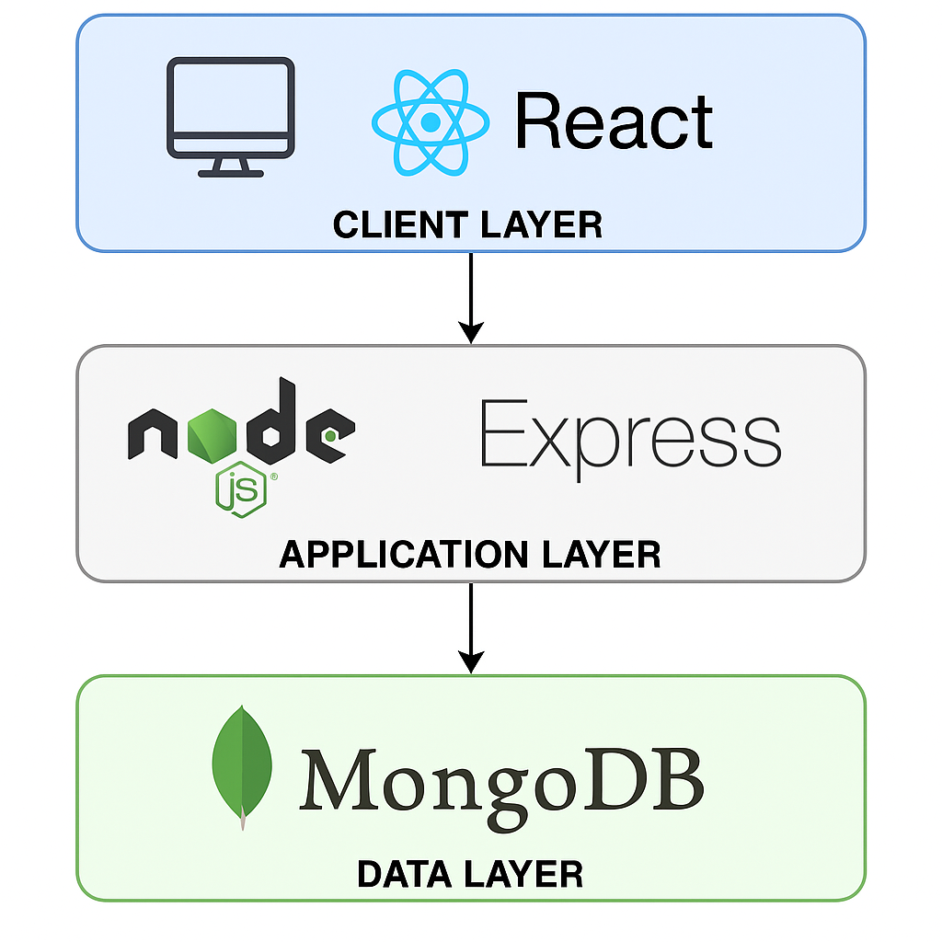
Final Technology Implementation

Slide 8
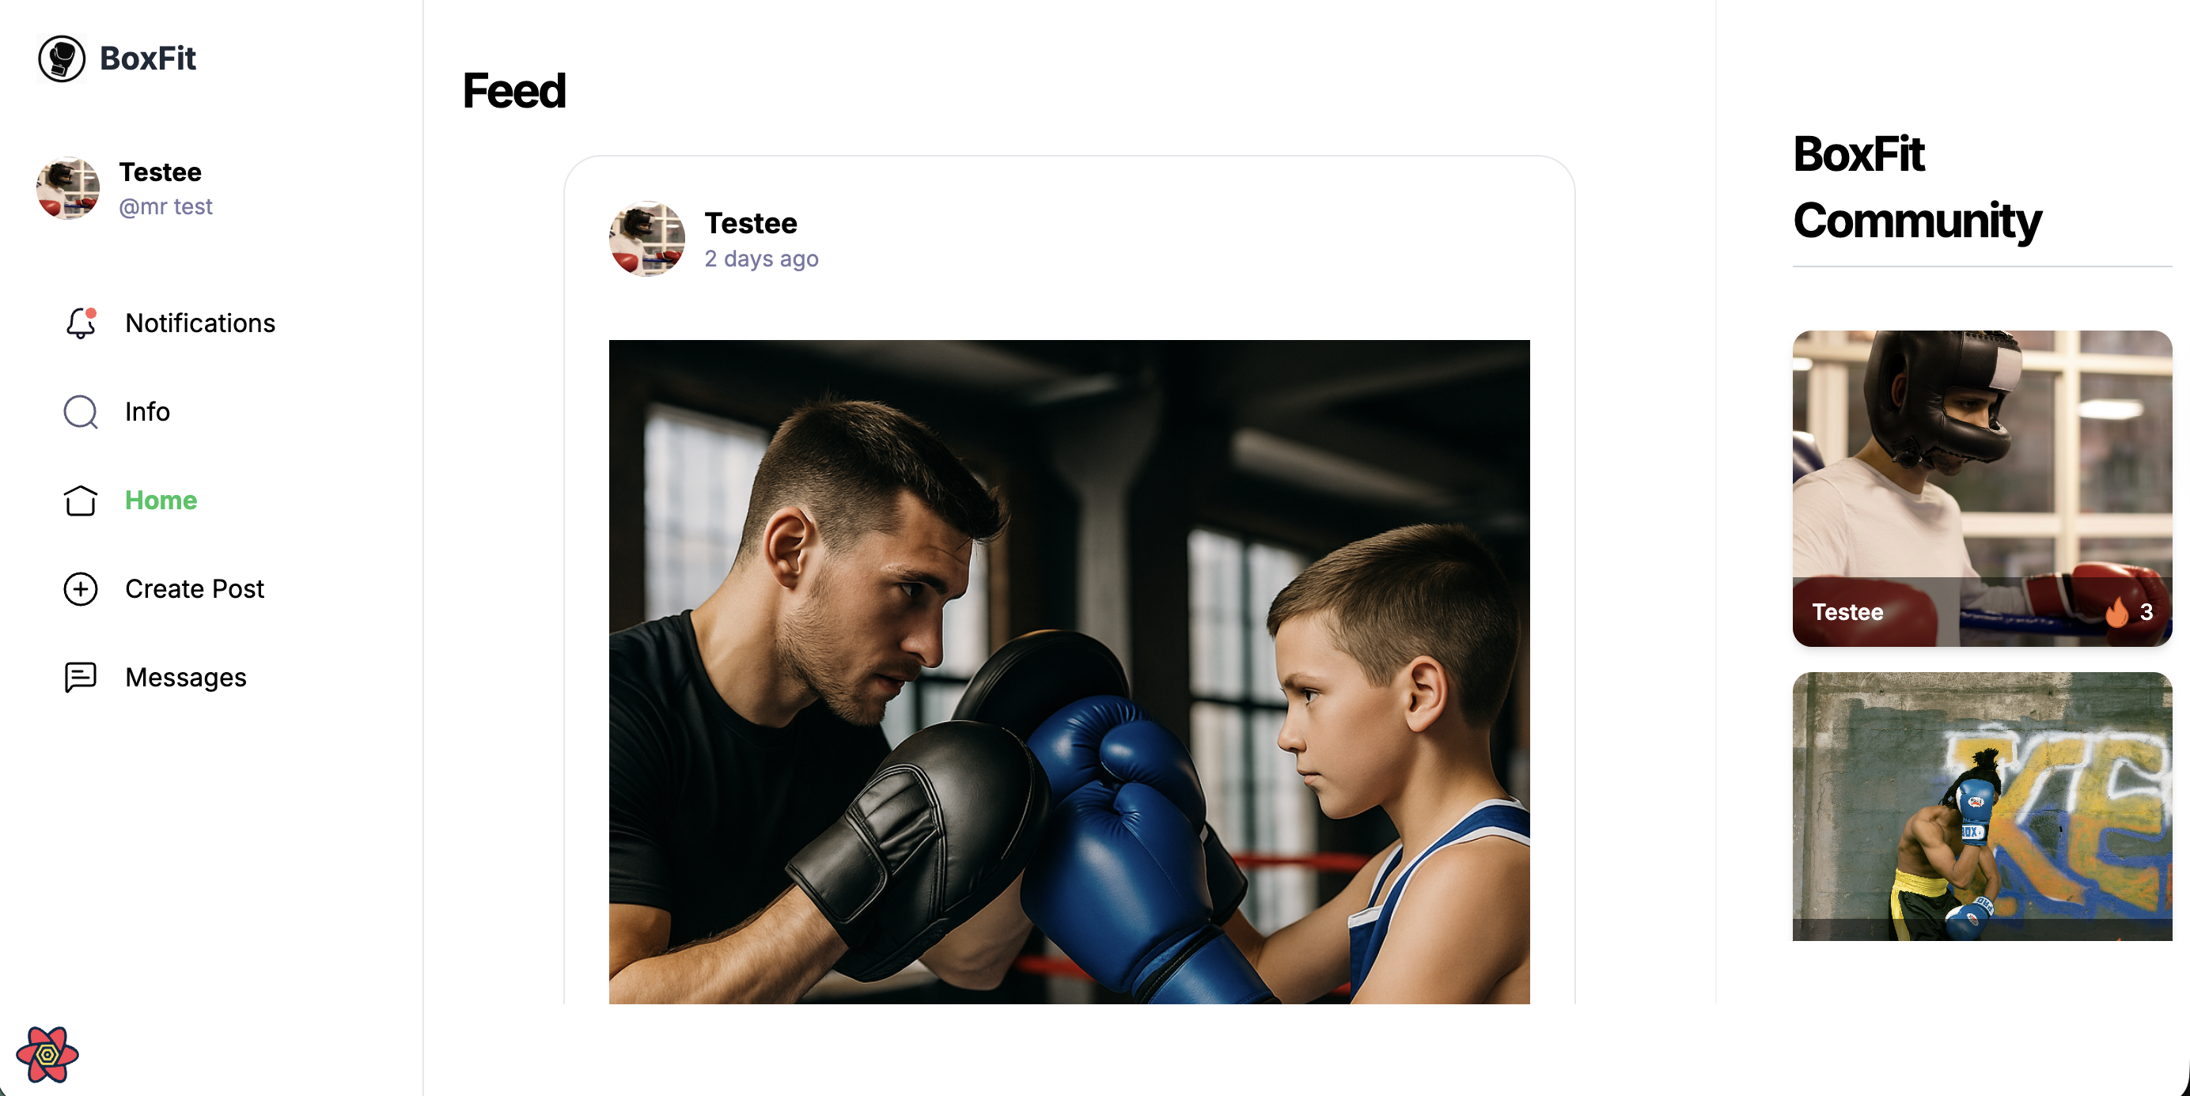
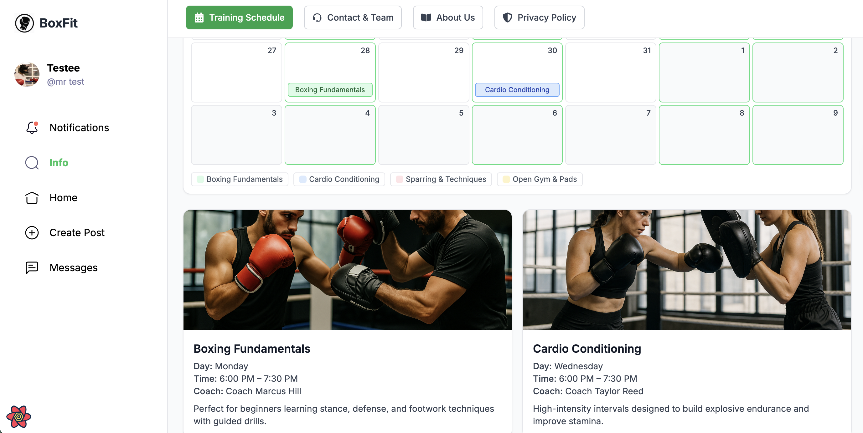
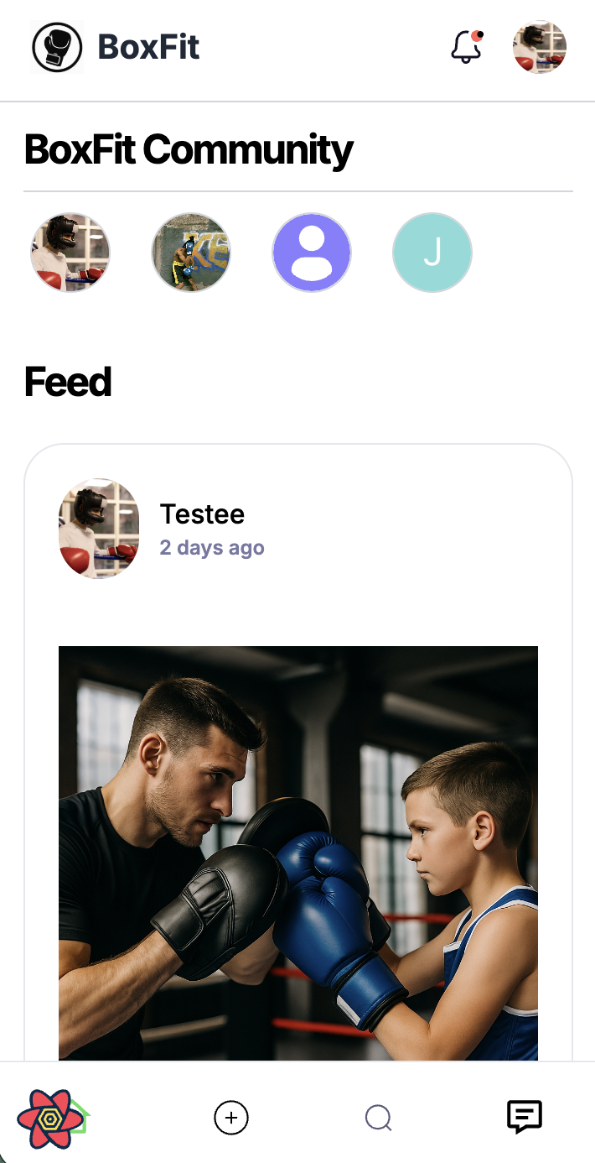
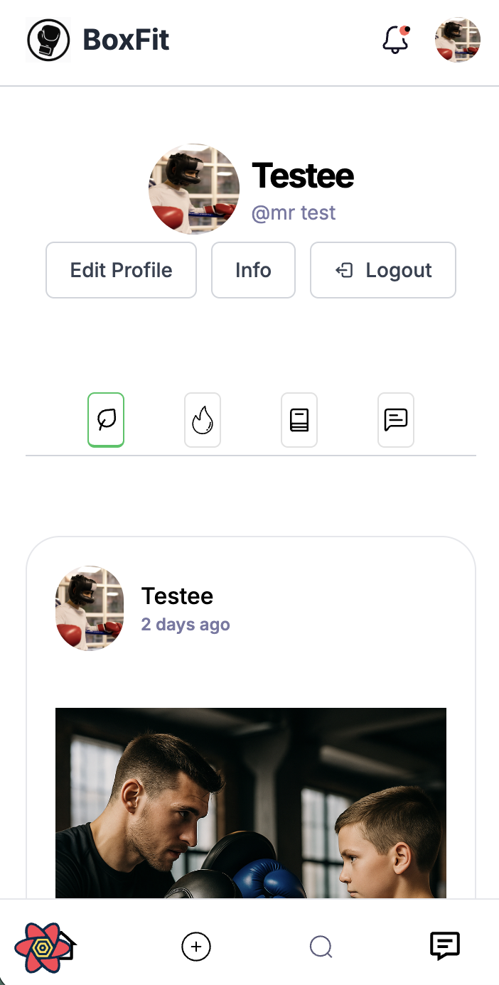
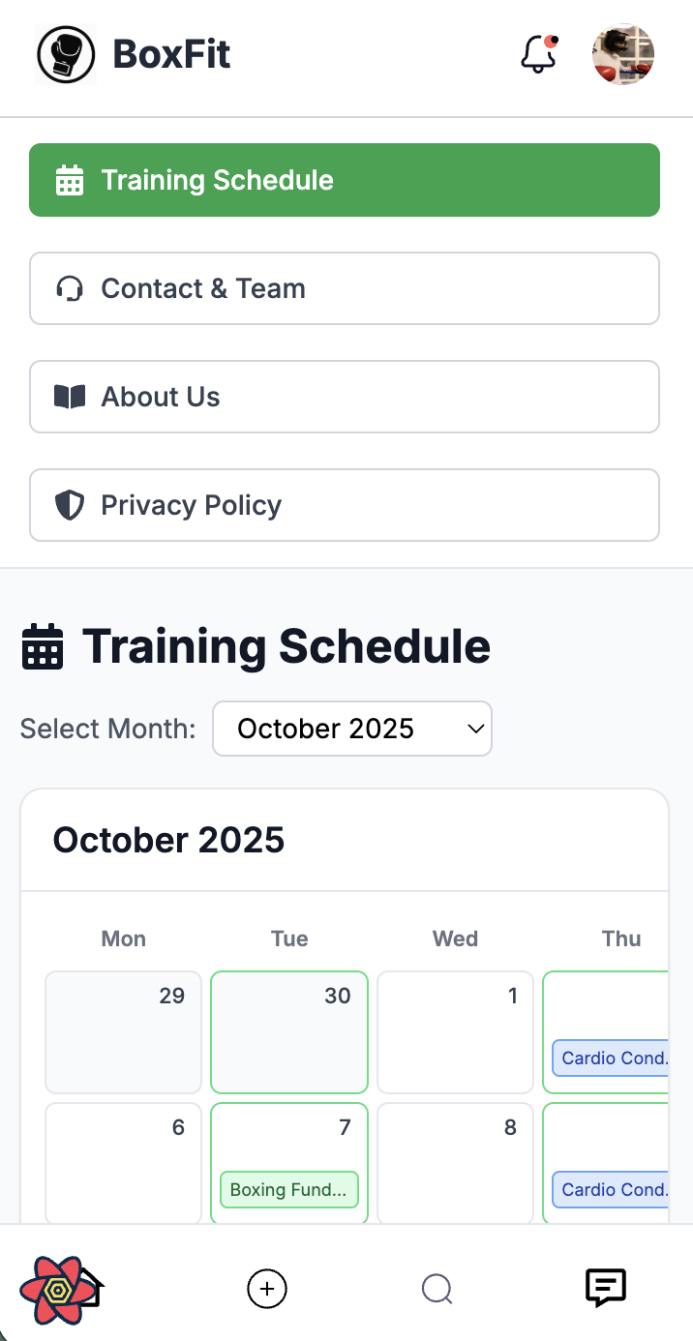
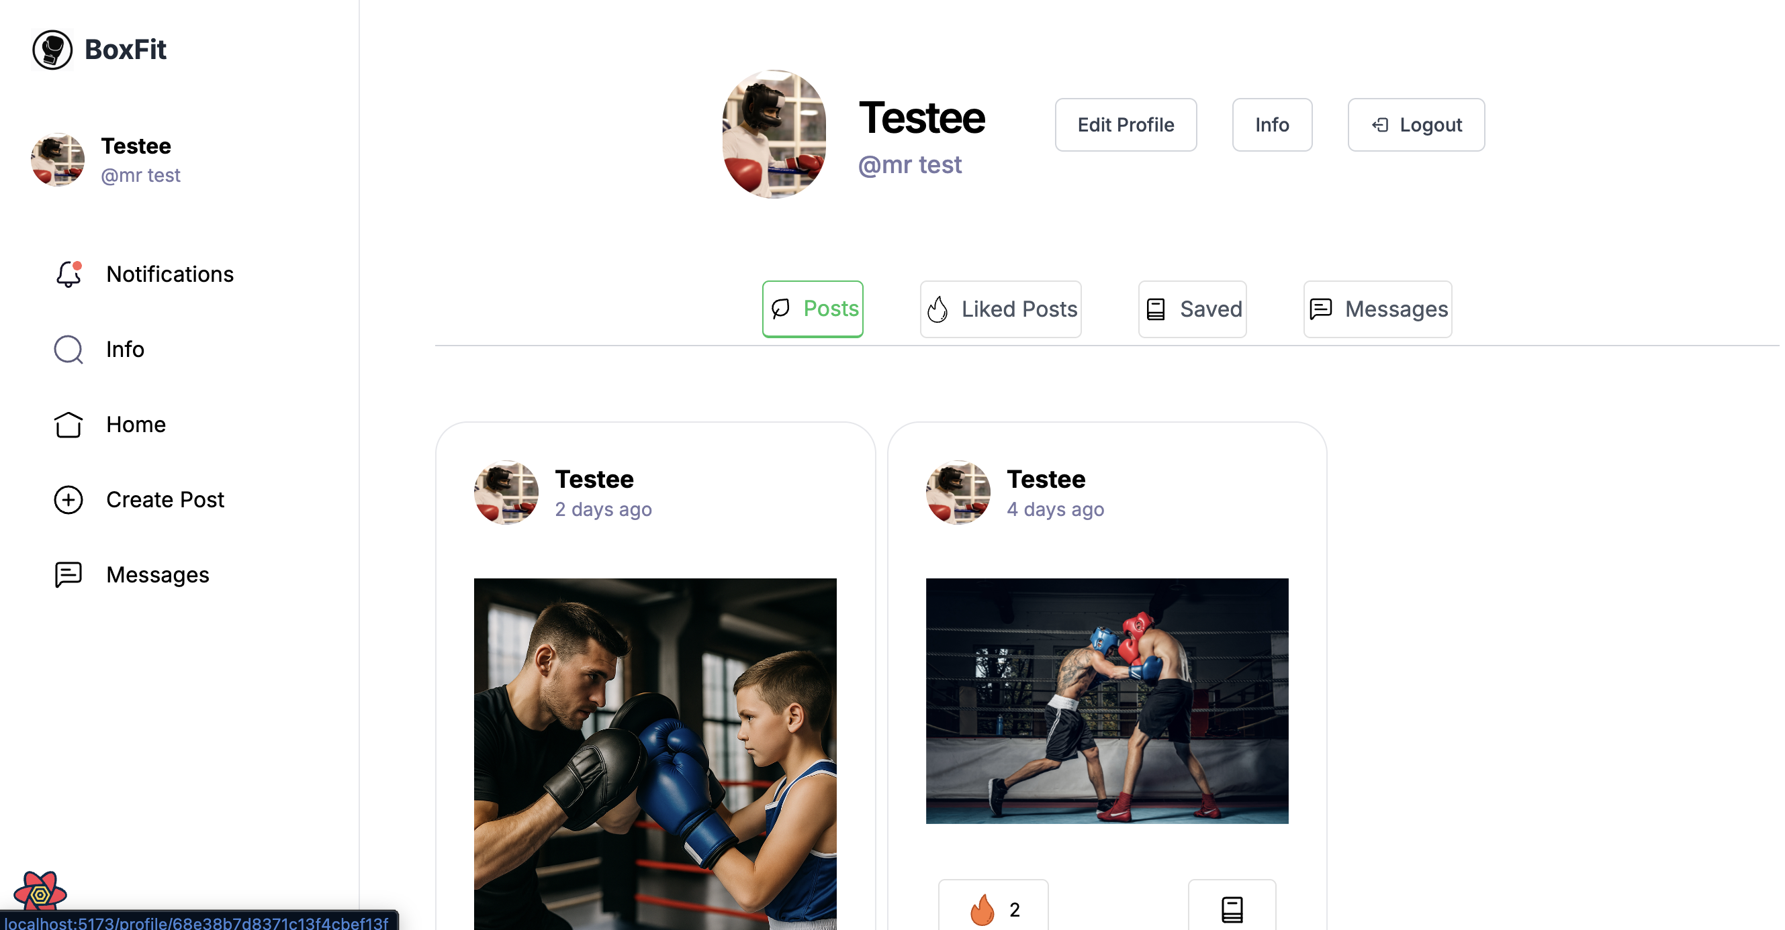
Application Showcase
Dashboard Desktop view
Info page Desktop view
Mobile view’s
Dashboard
Profile page Desktop
Site Features Overview
-Home Page: Displays all community posts, training updates, and shared media. Users can like, comment, and engage with others’ activity in real time.
-Profile Page: Shows each member’s personal details, bio, and post history. Includes follower and following counts, and an option to edit personal information.
-Information Page: Static page describing BoxFit’s mission, training philosophy, and gym policies. Provides useful background and guidelines for all members. Central hub for gym announcements, events, and training updates. Allows administrators or coaches to keep members informed about upcoming sessions or news.
-Messaging: Real-time private chat between members. Enables seamless direct communication with responsive layout across devices.
-Notifications: Alerts users to new likes, comments, followers, or messages. Keeps members engaged and updated continuously.

Slide 9
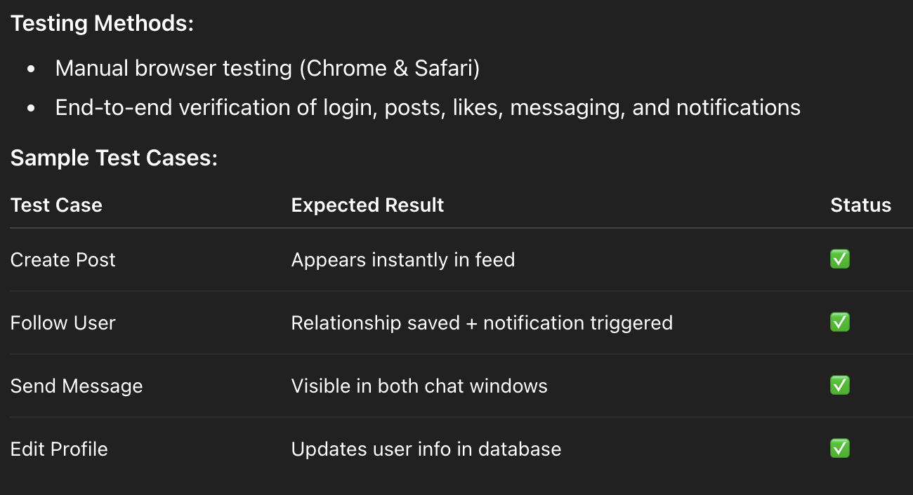
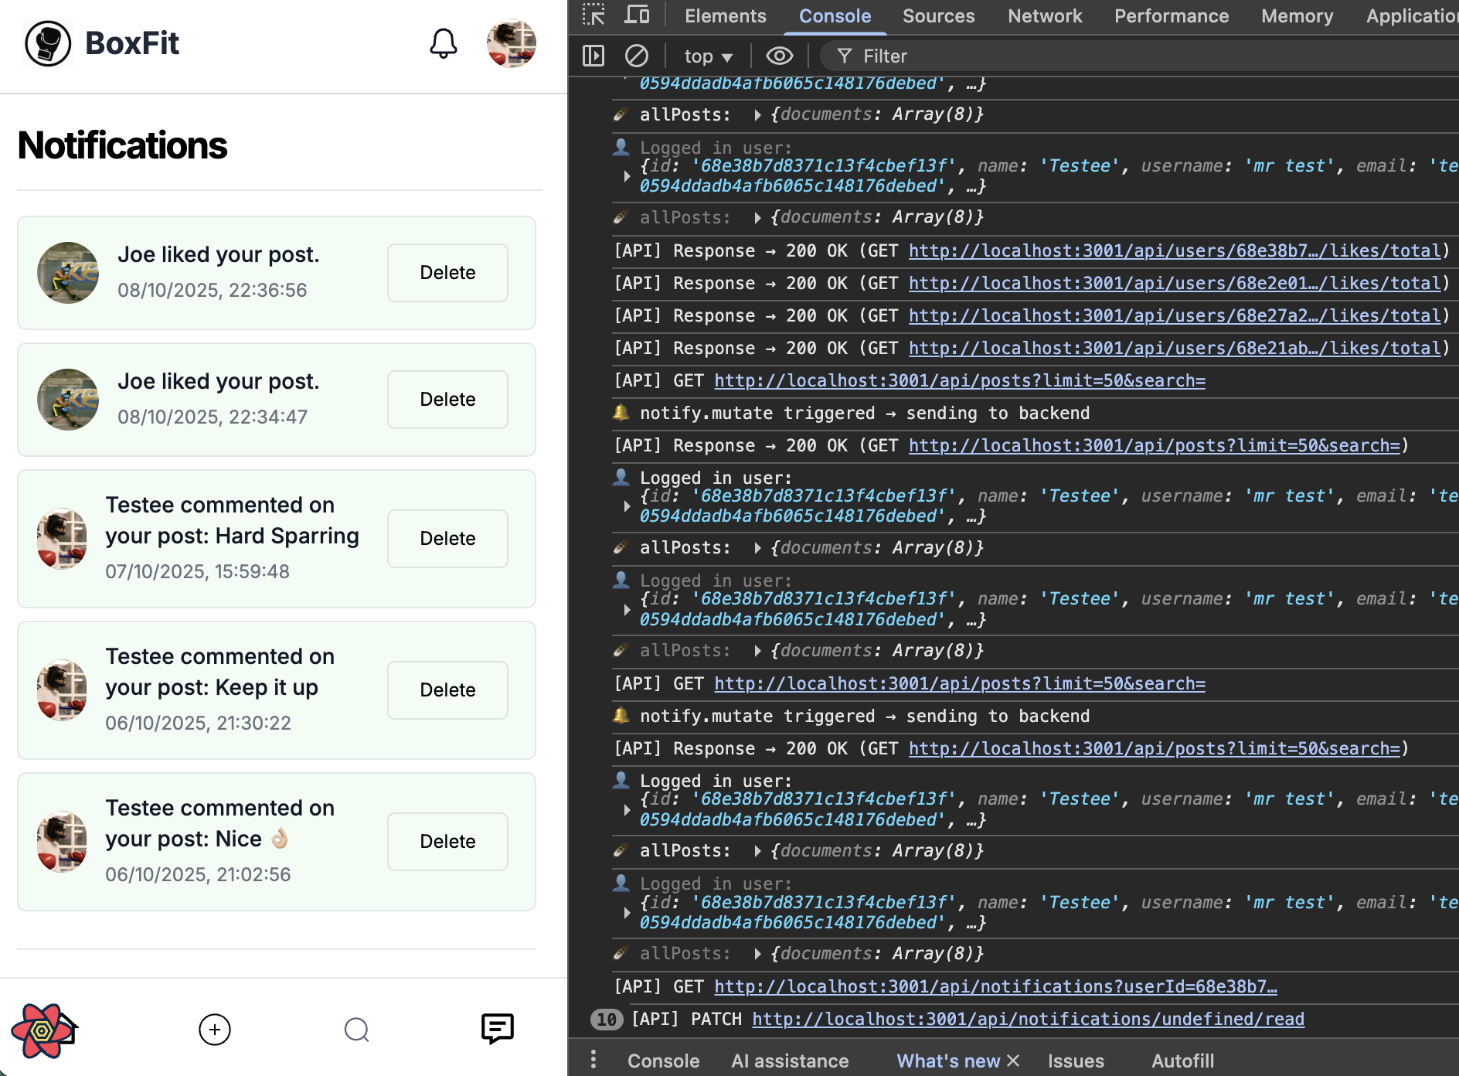
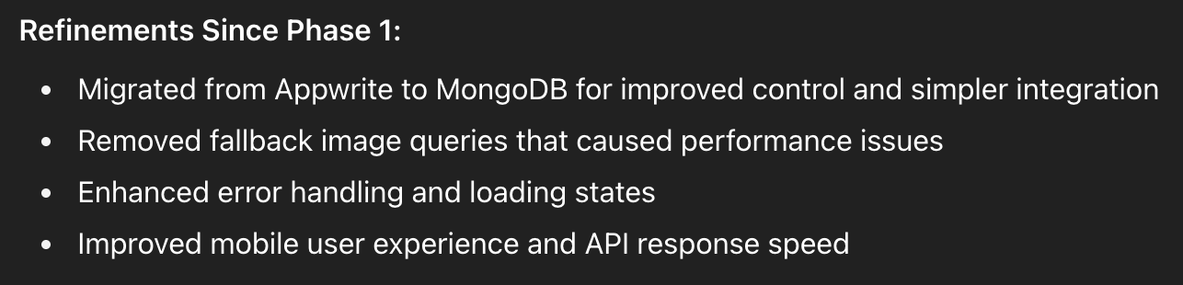
Testing & Refinements

Slide 10
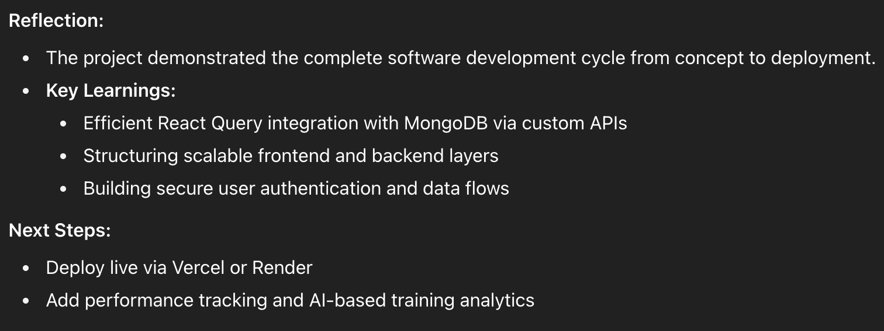
Reflection & Screencast Summary

